Slide 2
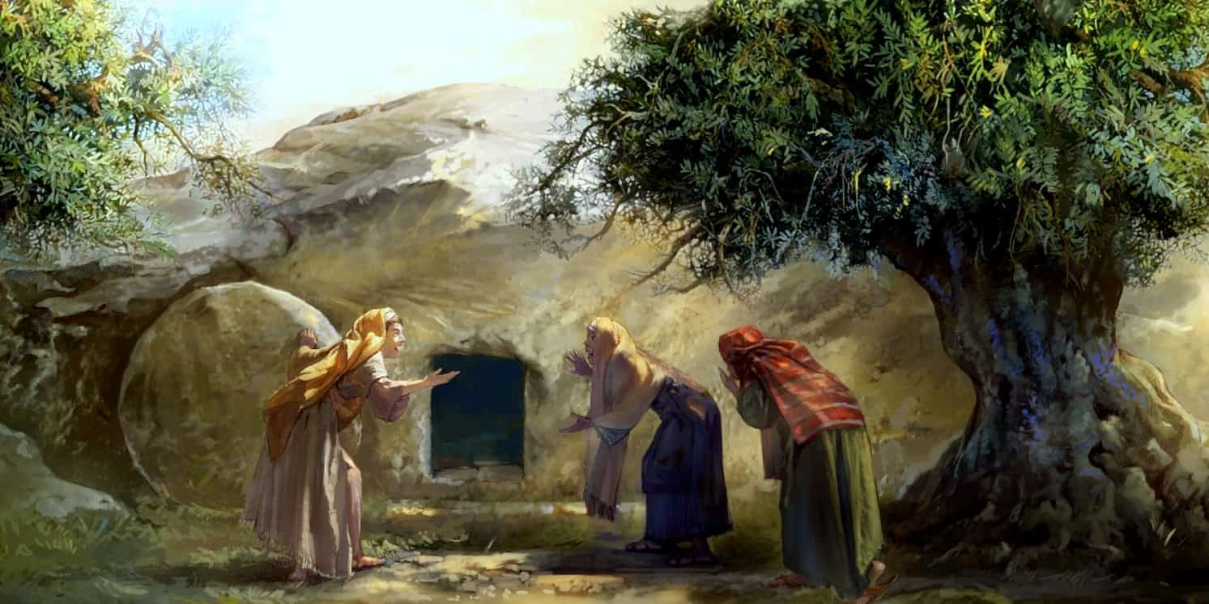
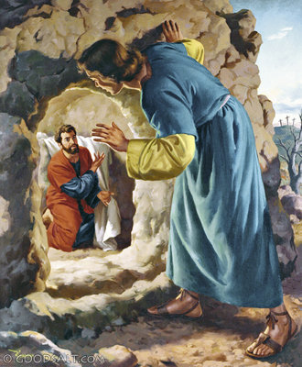
Seeing the Risen Jesus
Not work of grave robbers (20:5-7)
Jesus’ followers believe not because of the empty tomb but because they saw Him alive

Slide 3
Seeing the Risen Jesus
Talks (20:16)
Touches (20:17)
Saw and talked (20:18)

Slide 5
Mary Magdalene
Luke 8:2
Mt 27:56; Mk 15:40; Jn 19:25

Slide 6
Mary Magdalene
Mt 27:61; Mk 15:47
Mt 28:1; Mk 16:1; Jn 20:1

Slide 7
Mary Magdalene
Lk 24:10
Mk 16:9; Jn 20:11-18

Slide 8
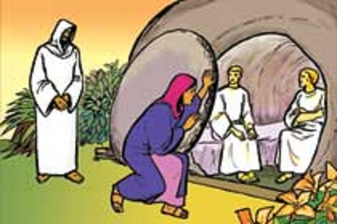
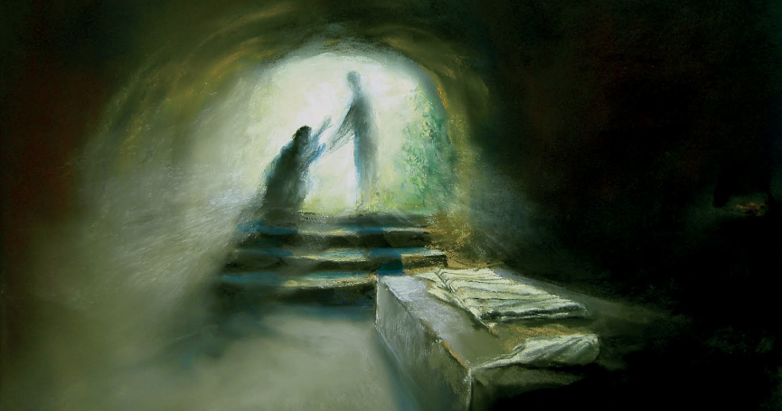
All four gospels mention Mary Magdalene in the Passion narrative
If there was a woman to leave out it was this one!
Celsus (wrote c. 175 AD)

Slide 9
Gospel writers were writing the truth and letting the chips fall where they may!

Slide 10
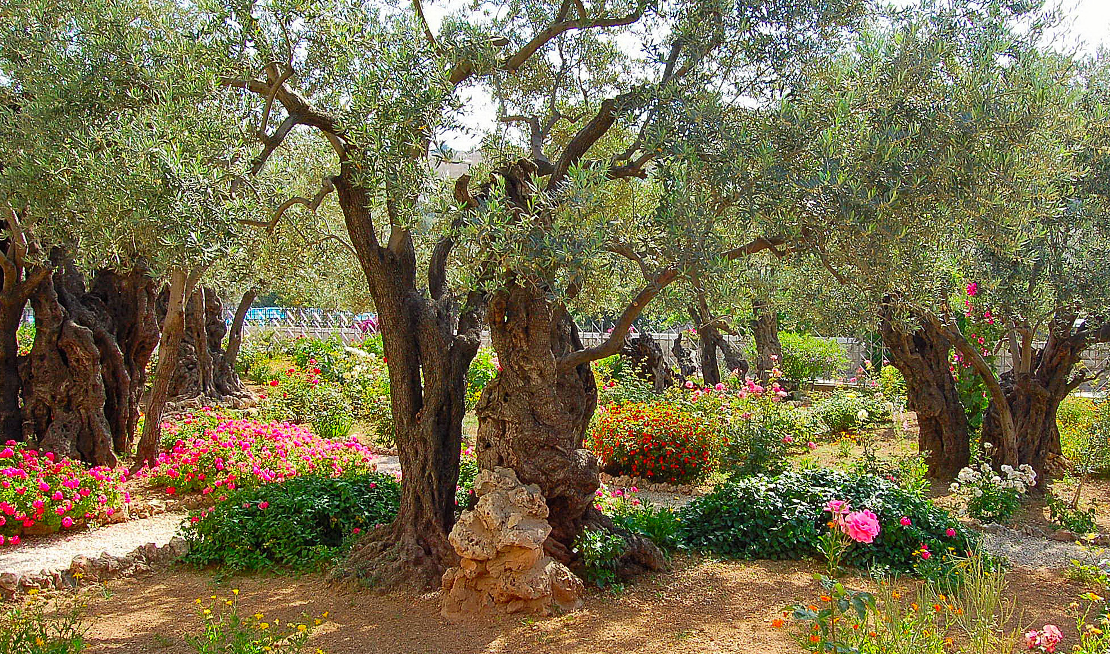
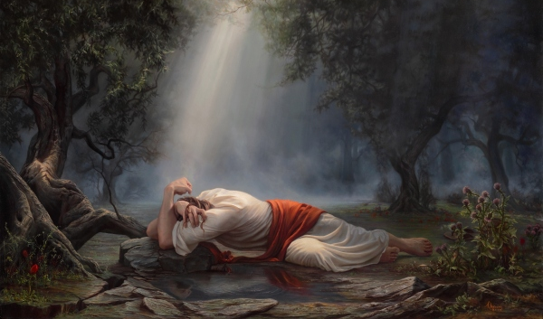
Garden
18:1
19:41
20:15

Slide 11
20:17
Not the final reunion
Best is yet to come

