Slide 1
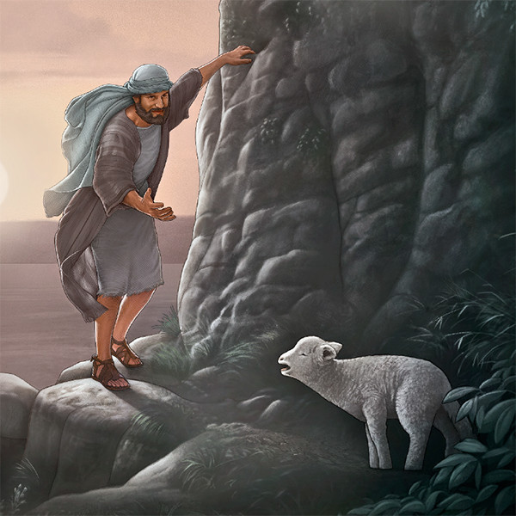
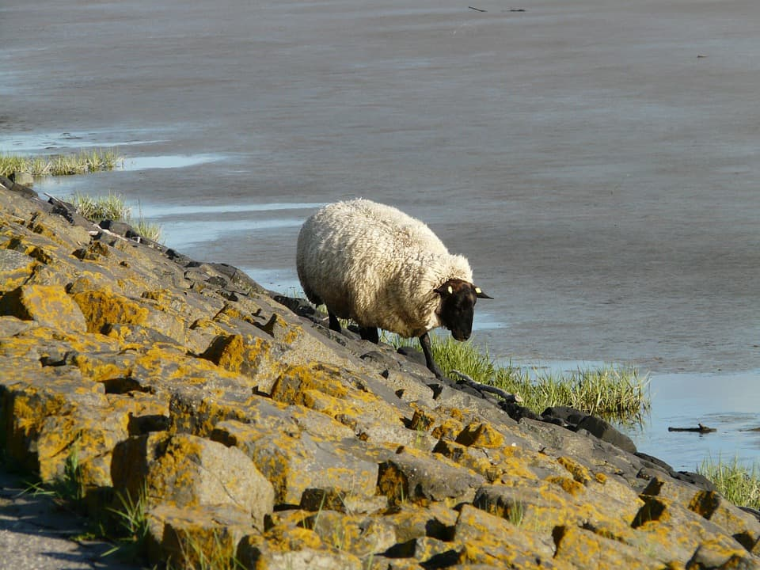
Matthew 18:12-14

Slide 2
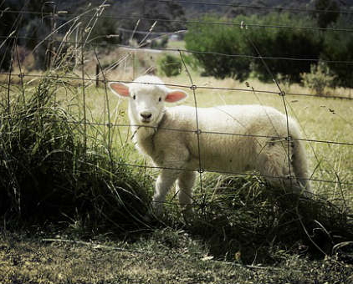
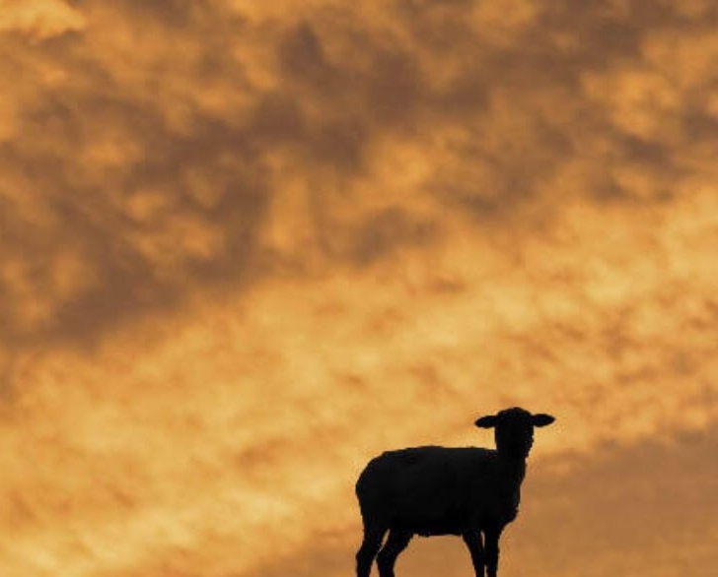
Lost Sheep
Parable of the Straying Sheep
Gone astray (18:12)
Straying (18:12)
99 who have not gone astray (18:13)

Slide 3
Parable of Straying Sheep
Not stuck
Not carried away by wild animal (Gen 31:39; 1 Sam 17:34-37; Amos 3:12)
Active in leaving

Slide 4
God’s Response
18:12
Mountains
Not easy
To God we all are valuable

Slide 5
IF… (18:13)
Not a guarantee
Joy!
Straying could lead us to perish
Restoration to Him and His people

Slide 6
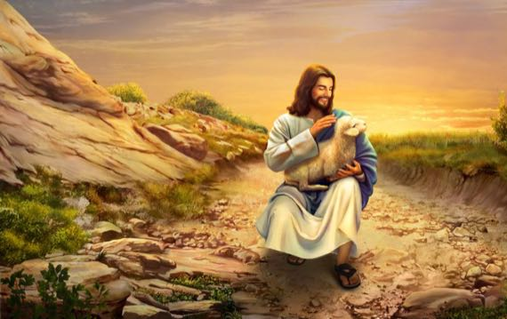
Sad Reality
1 Peter 2:20-25
We have strayed
Joy
Cease to stray

