Slide 1
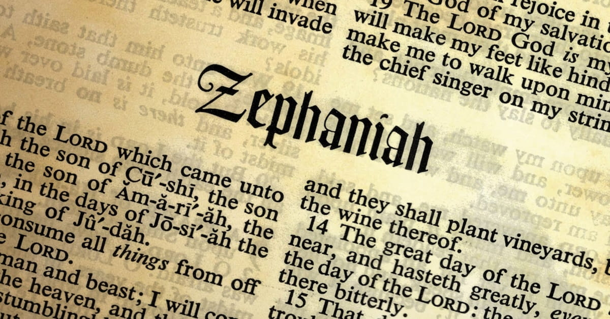

Slide 2
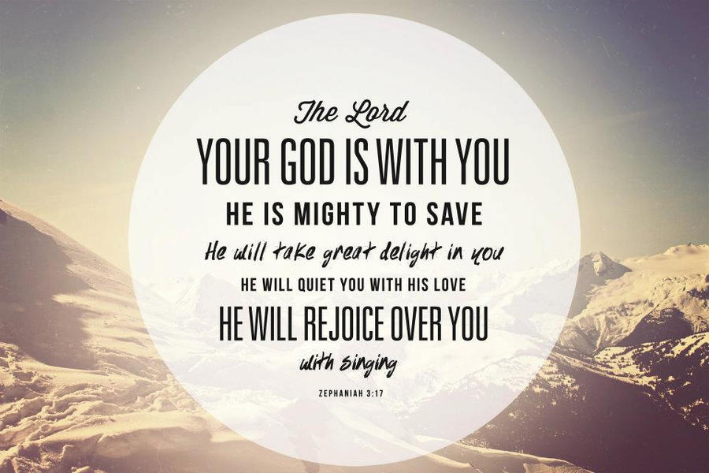
1:1
Josiah (640-609 BC)
2 Kgs 22-23; 2 Chron 34-35
Righteous king, law lost
Reform…
Judgement coming (2 Kgs 22:14-20; Jeremiah)

Slide 3
Judgement
Day of the Lord (1:7-10, 14-18; 2:2-3)
Judgment on the nations (2:4-3:7)
De-creation language (1:2-3)

Slide 4
Who?
Not fully devoted (1:5)
Keeping word (Josh 2:12; 6:22)
Dt 6:13
Dt 10:20
Milcom, god of Ammon (1 Kgs 11:5, 33; 2 Kgs 23:13)

Slide 5
Who?
Naaman (2 Kgs 5:15-18)
Turned back (1:6)
Enoch, Noah, Abraham
Ps 78:56-58

Slide 6
Who?
Not seek Lord/inquire of Him (1:6)
Relationship with God was not precious
2 Kgs 22:13

Slide 7
Who?
Stagnant (1:12)
No growth

Slide 8
Application
Fully devoted (Mt 6:19-24)
Walked away (Rev 2:4)
Seeking Lord (Mt 7:7; 13:44-46)
Growth?

