Slide 3
Family
Fundamental social group in society typically consisting of one or two parents and their children.

Slide 4
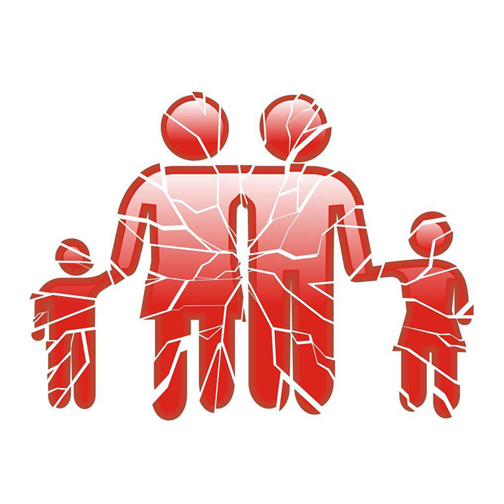
Family under Attack
Gen 3
Gen 4
Gen 13
Gen 27
Gen 30-31
Gen 37

Slide 5
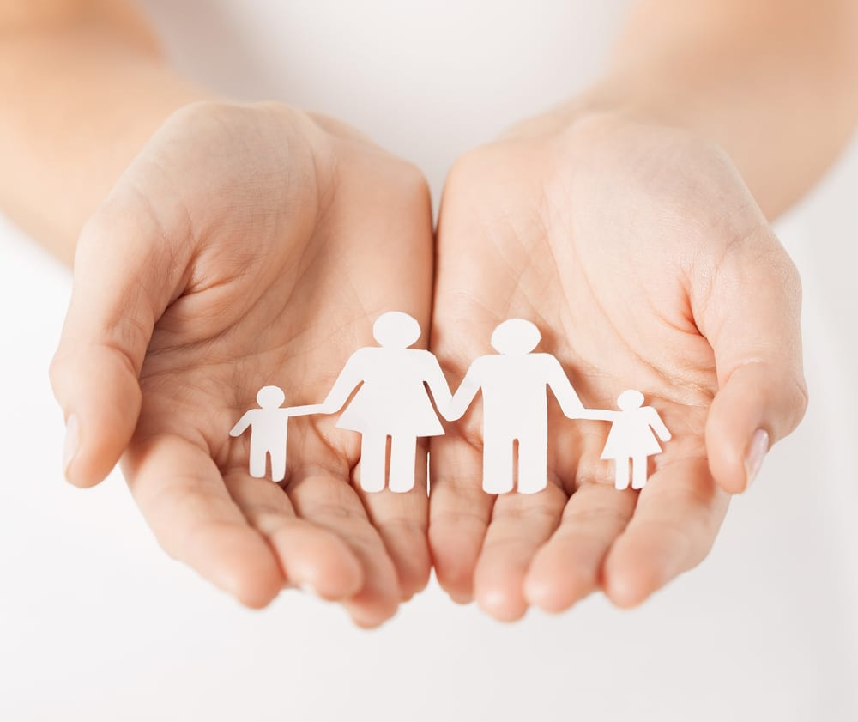
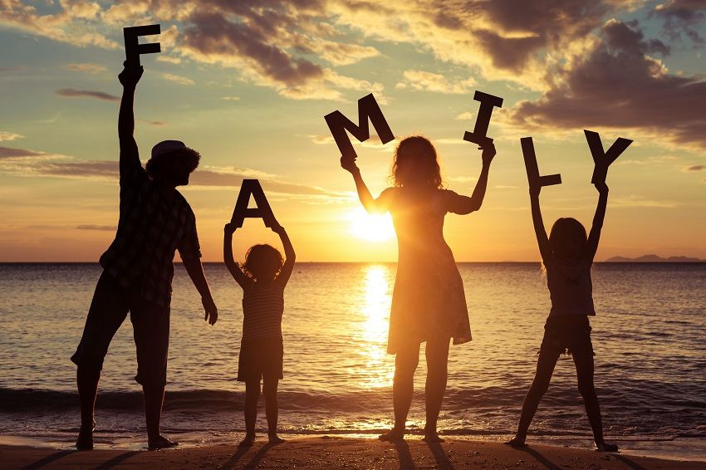
Family important to God
Not surprised by Family conflict
Expect satan will attack

Slide 6
Worship is Central
Exodus 12:21-28
Dt 6:7, 9
Dt 11:19-20
Josh 4:20-22

Slide 7
Godly Wisdom
Prov 1:8; 5:1
Parables
Adulterous (Prov 5:8-14)
Naïve (Prov 7:1-23)
Drinking (Prov 23:29-35)
Sluggard (Prov 24:30-34)

Slide 9
Reconciliation and Forgiveness
The family is a place where reconciliation and love are on display despite our failures

Slide 10
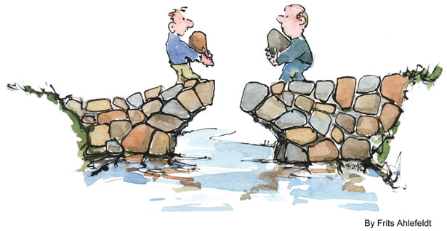
Reconciliation and Forgiveness
Jacob and Laban
Gen 31:44-55
Jacob and Esau
Gen 32-33
Gen 36:6-7

Slide 11
Reconciliation and Forgiveness
Joseph and Brothers
Gen 45-50
David and Absolom
2 Sam 18:31-33

Slide 12
Reconciliation and Forgiveness
Hosea and Gomer
Hos 3
In all of these cases people knew what they were doing

Slide 13
Reconciliation and Forgiveness
Isa 49:14-16
Hos 2:19-20
Imperfect families becomes a place to reflect the perfect love of God

Slide 14
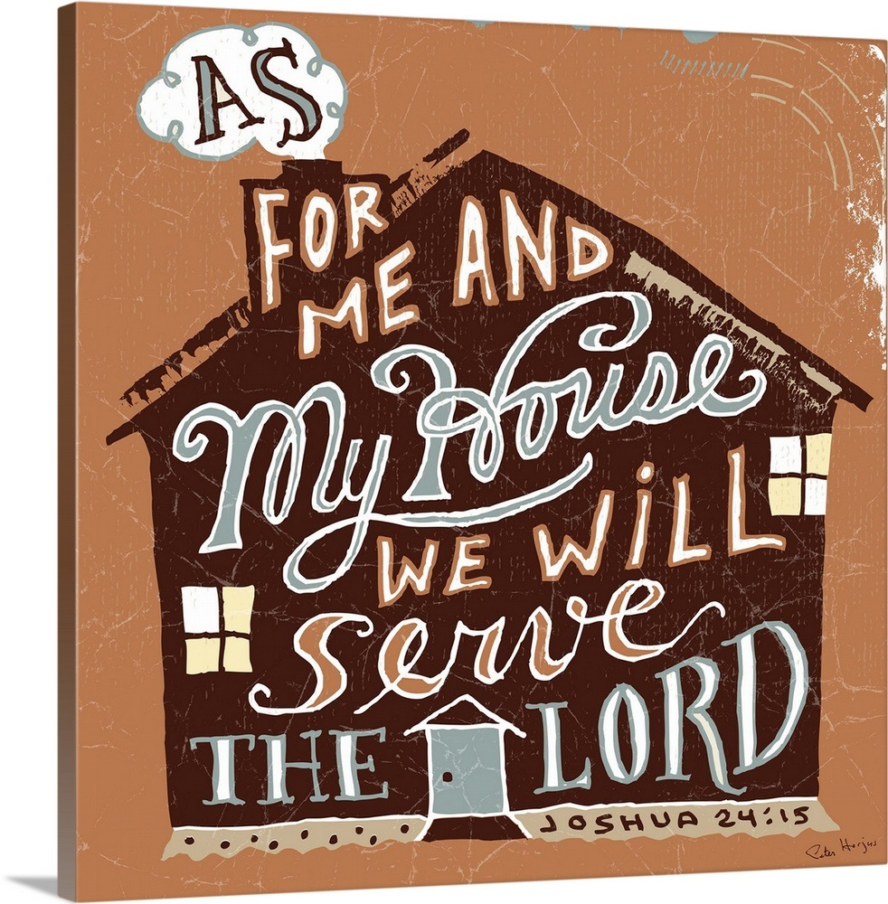
Defense against Decay
Joshua 24
Hold Family to God’s standard
Realize who you can influence
24:14, 19, 24

Slide 15
Jeremiah 35
Family that is separate
35:6-11
35:18-19
Illustrate how to live separate

Slide 16
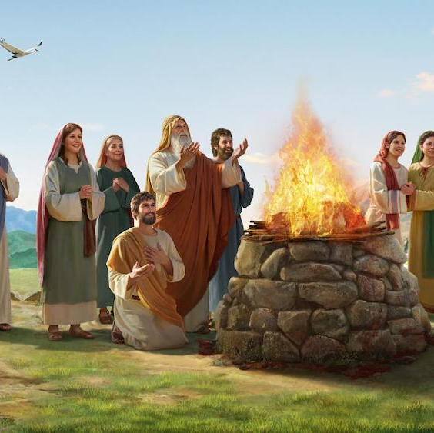
Noah
Righteous Noah saved his family
Gen 6:18; 7:1, 7, 13; 8:16, 18; 9:1
Heb 11:7
Eternal difference

Slide 17
Serve

Slide 19
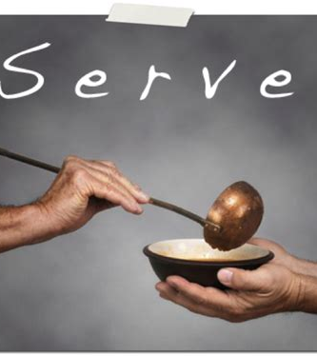
God’s Design
Reflect what sacrificial love looks like
Prov 13:22; Eccl 7:11-12

Slide 20
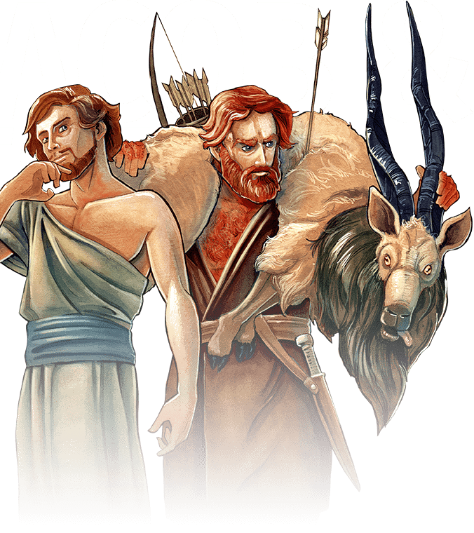
Problem
Gen 27
No hint of sacrificial love!

Slide 21
Positive: Husband, Father
David (2 Sam 18:33)
Eph 5:25-30
Christ’s Sacrificial love
Own body

Slide 22
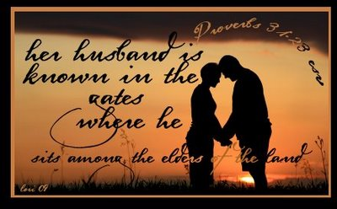
Positive: Wife and Mother
Husband
31:11-12
31:23
31:28-29

Slide 23
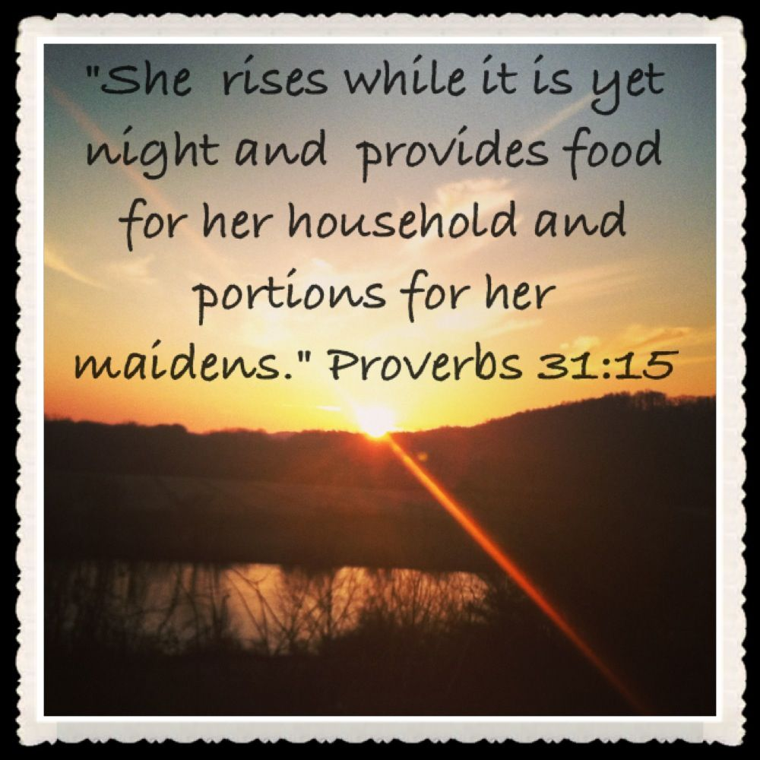
Positive: Wife and Mother
Household
31:15
31:21
31:27

Slide 24
Positive: Wife and Mother
Children
31:28

Slide 25
Call to Children
1 Tim 5:3-8
Positive: 1 Tim 5:4
Negative: 1 Tim 5:8

Slide 26
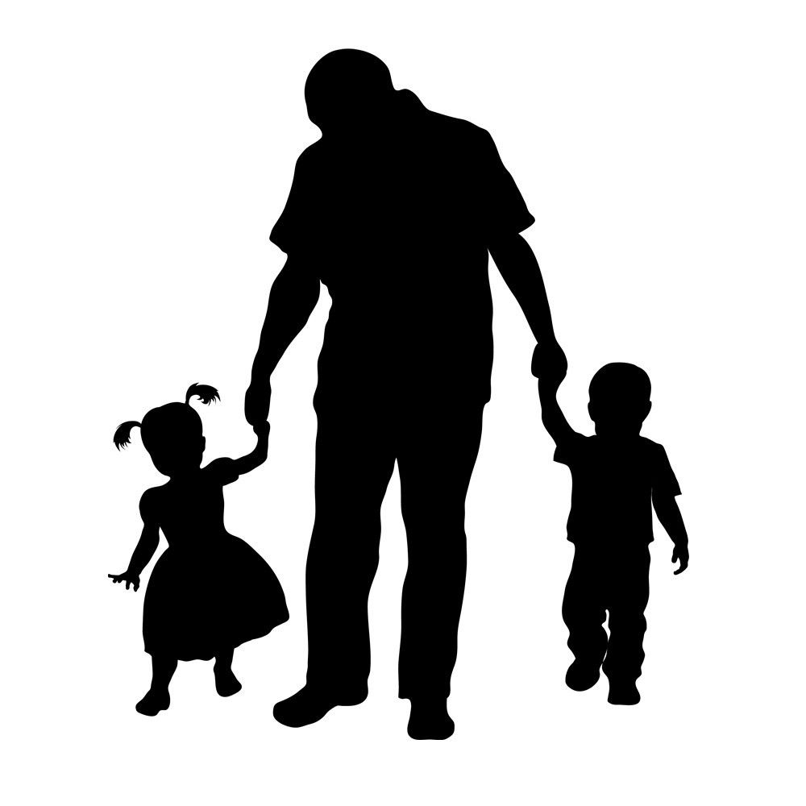
Father to Children: Be careful how and were you walk
Children: We will just follow you…

Slide 27
Positive: Ruth
Urged to Return (1:8, 14-15)
Declaration (1:16-18)
Praise for Ruth
2:6
2:11-12
3:11
4:15

