Slide 1
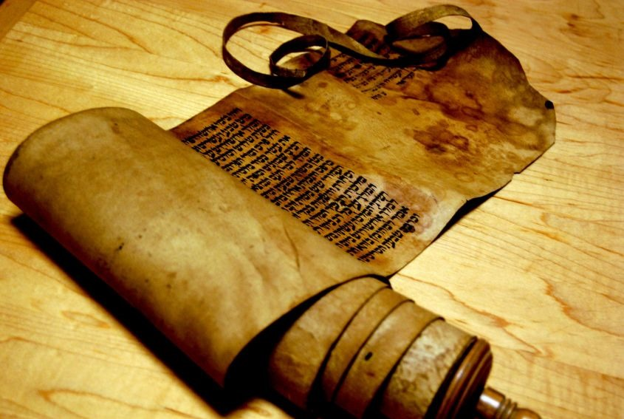
Message of Ezekiel 20

Slide 2
Elders come to inquire of the Lord
8:1
14:1
20:1

Slide 3
Why?
14:3; 20:3
History of Rebellion
20:5-31: From Egypt to entering the Promised Land

Slide 4
Pattern of the Nation
Cycle of the Chapter:
God reveals
Gives instructions
Nation violates
God spares

Slide 5
Israel’s Violations
Idolatry (20:7, 28, 32)
Statues and Ordinances (20:11, 13, 16, 19, 21, 24)
Violations of Sabbath (20:16, 21, 24)
Blasphemed (20:27)

Slide 6
Different way to View Story
20:8-9
20:13-14
20:21-22
Consequences (20:15, 23)

Slide 7
Received Grace but persisted in sin
Rom 6:1-2

Slide 8
Response to Grace
20:32-44: Purging and Restoration
20:43-44

