Slide 1
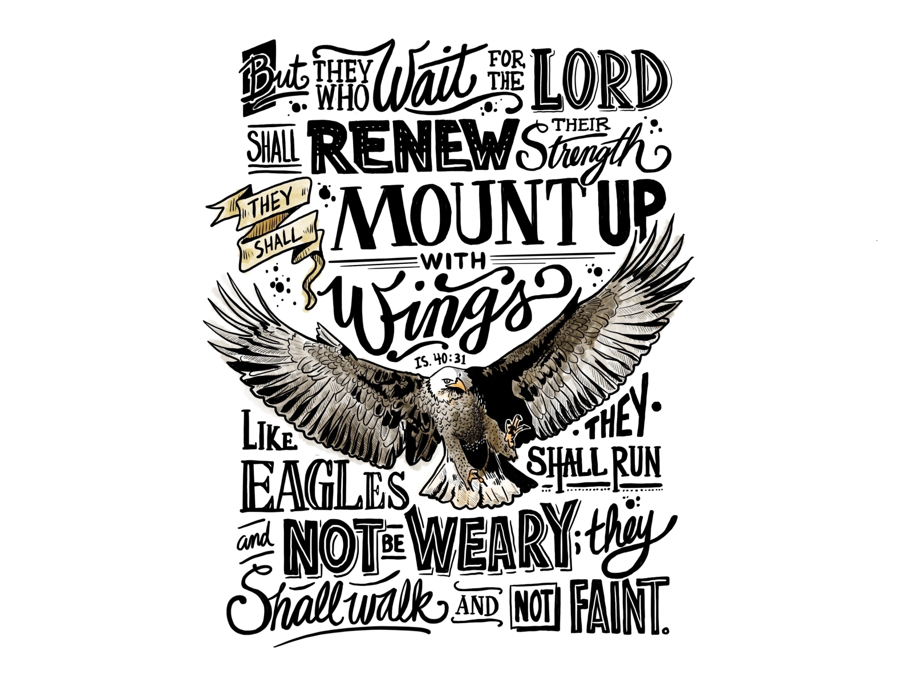
Isaiah 40:12-31

Slide 2
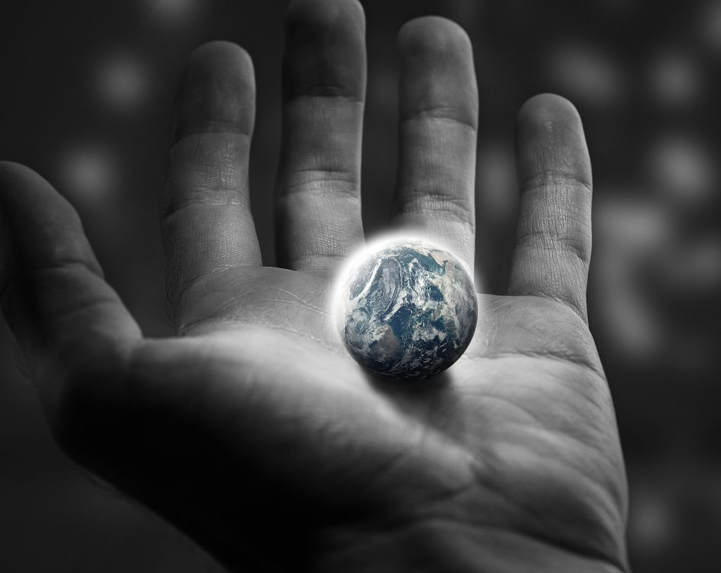
40:12
Four rhetorical questions (40:12)
Psalm 33:6-7
James Webb Telescope (Dec. 25, 2021)

Slide 3
If we cannot measure creation how can we comprehend the power of the Creator?
John Oswalt

Slide 4
40:13
Prov 8:22-31
Ps 94:10; 119:66

Slide 5
40:15-17
Drop and Speck (40:15)
Meaningless (40:17)
No sacrifice adequate

Slide 6
Lessons
Folly of idolatry (40:18-20)
Nations or leaders (40:21-26)
No problem is too great for this God (40:27-31)

